Slide 1


Slide 2

NY Crashes WebApp
Project 3, Group 1
GWU Bootcamp
Prepared and Presented by:
Adal, Louie, Patricia, Raheleh, and Rasha
4/24/2023

Slide 3
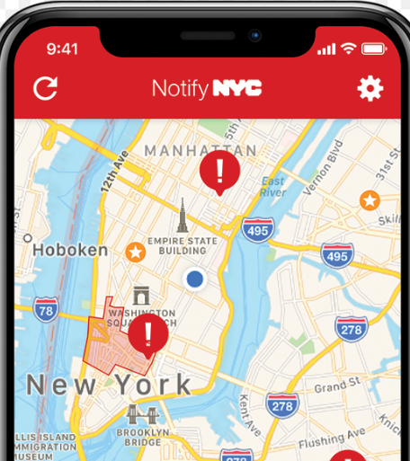
Who will this WebApp inform?
Individuals concerned about traffic safety:
Police departments monitoring traffic safety
Urban planning professionals
Traffic management applications for building smart cities
Mapping, navigation, and route planning businesses
Location intelligence companies
General populations looking to relocate
1
Notes:
Raheleh

Slide 4

Data Exploration and Cleaning:
The data exploration and cleanup process
Fetched the data from NYC Motor Vehicle Collisions OpenData website
Saved the CSV files to our local drive
~1.98M rows of data, updated daily
○ Only used January 2022- December 2022 (~69K, cleaned data: ~42K)
● Source: NY Police Department (NYPD)
CSV Request
Pandas df
to
Requests
(.json)
Dropped Null Rows
Did not have vehicle type, borough, crash factor
Changed Datatypes
Date to datetime64 “yyyy/mm/dd”
Numbers to “int”
Lat/Lon to “float”
Dropped Columns
(29 to 14), and added new Column (1, index)
Saved as PostgreSQL
Created an sqlalchemy engine
Extract
Transform
Load
2
Notes:
Louie

Slide 5








WebApp
Data
3
Notes:
Louie

Slide 6
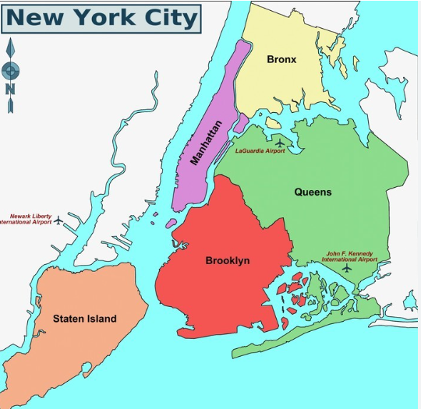
NYC Five (5) Boroughs:
4
Notes:
Rasha

Slide 7
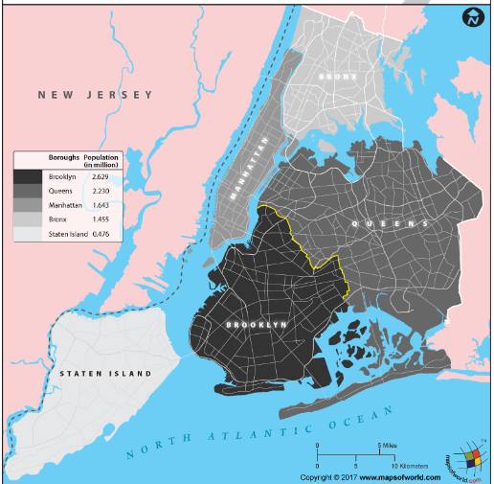
NYC Five (5) Boroughs’ Populations:
5
Notes:
Rasha

Slide 8
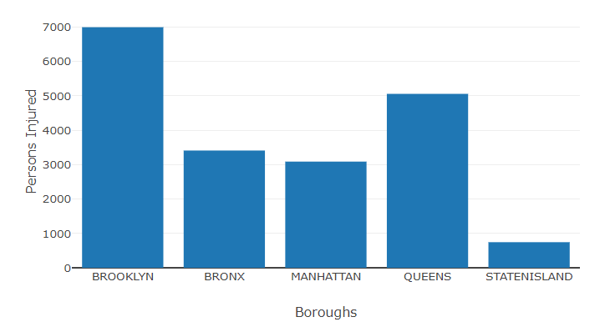
Annual NYC Persons Injured’ s Crashes per Borough:
6
Notes:
Patricia

Slide 9
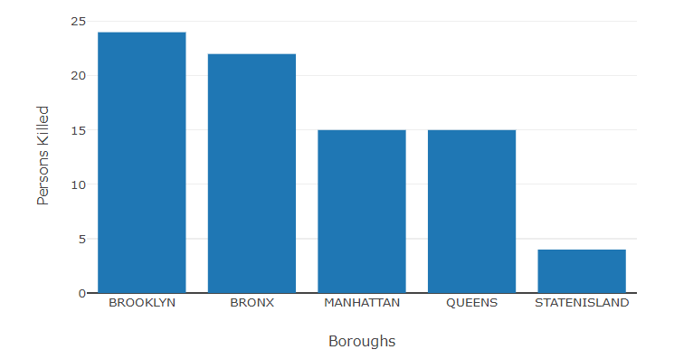
Annual NYC Persons Killed’ s Crashes per Borough:
7
Notes:
Patricia

Slide 10
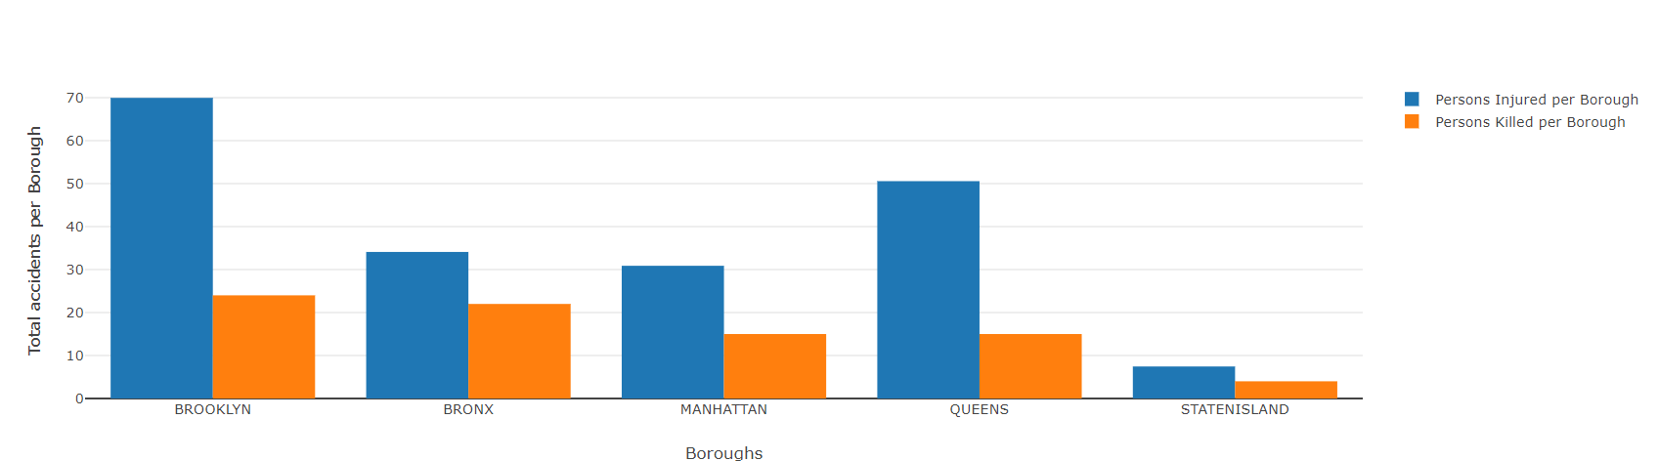
Annual NYC Persons Injured/Killed’ s Crashes per Borough:
8
Notes:
Adal

Slide 11
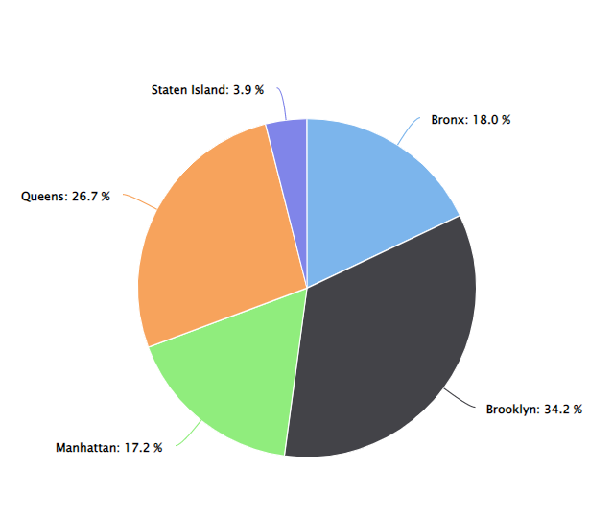
Percentage of Vehicle Crashes per Borough:
9
Notes:
Adal

Slide 12
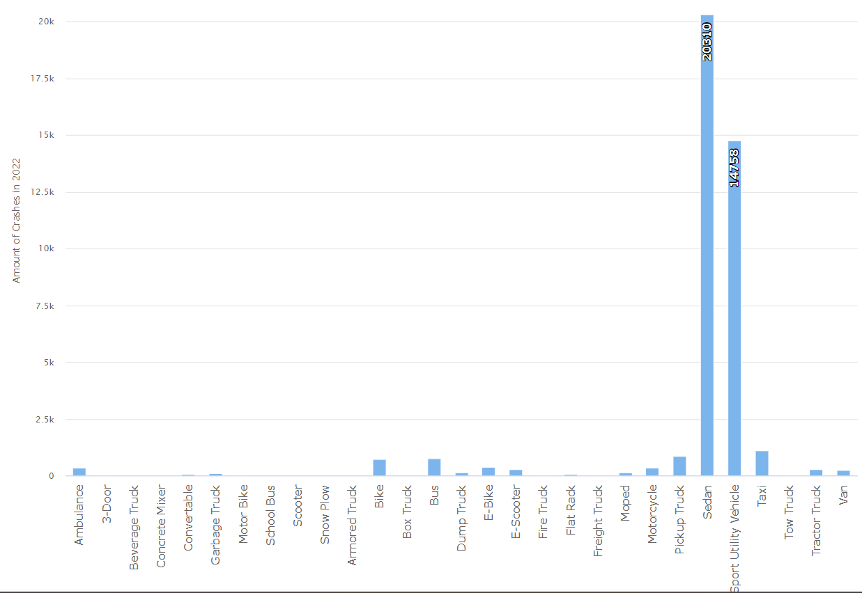
Vehicle Type Crashes:
10
Notes:
Adal

Slide 13
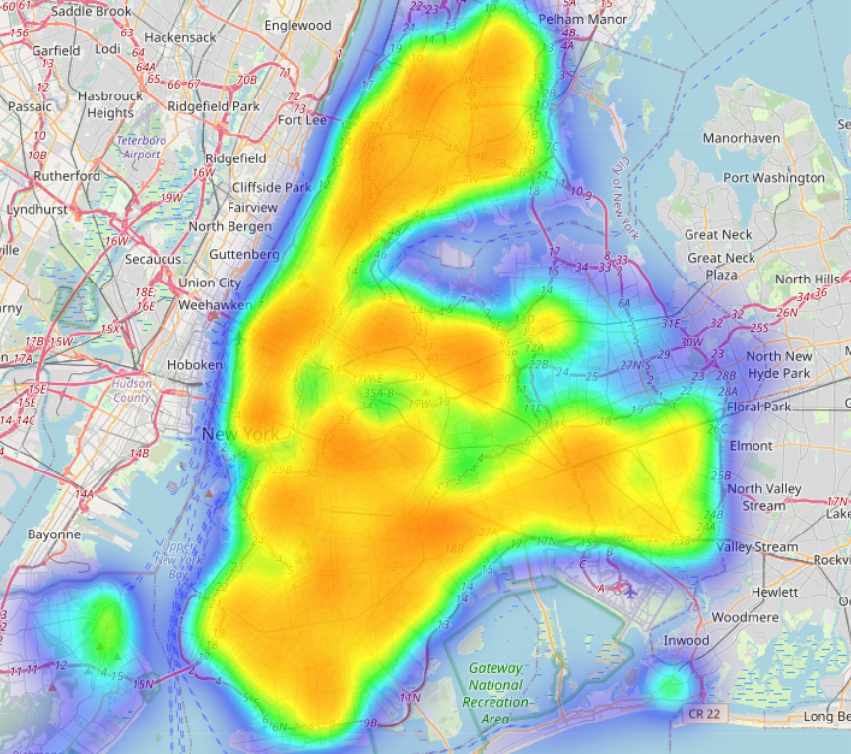
NYC Crashes and Heatmap:
11
Notes:
Adal

Slide 14
DEMO
12
Notes:
Raheleh

Slide 15



Questions
13
Notes:
Raheleh

Slide 16
Project and Data Links:
GitHub
https://github.com/rvafaeis/project_3_data_visualizations
Data Links
https://data.cityofnewyork.us/Public-Safety/Motor-Vehicle-Collisions-Crashes/h9gi-nx95
https://www.mapsofworld.com/answers/united-states/nyc-largest-borough-by-population/#
16

